Slide 1
Web Scraping with Python
Turning Web Pages into Social Insights
JAVA
UI
</>
Saijal Shahania and Dr. David Broneske
Hanover, 11.09.2024
UX

Slide 2
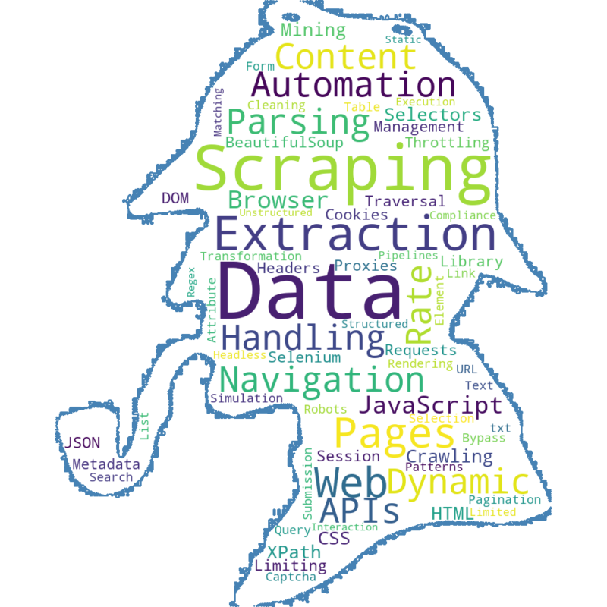
What is Web Scraping?

Slide 3
Why Web Scraping?
Applications
Data Access
COMPARaTIVE Studies
Job Ads
Propaganda
Real Time
niche COMMUNITIES
Current News
Support Groups
Cost-Effective
Hist. Archiving
Automating Data Collection
Exit vs Opinion Polls

Slide 4
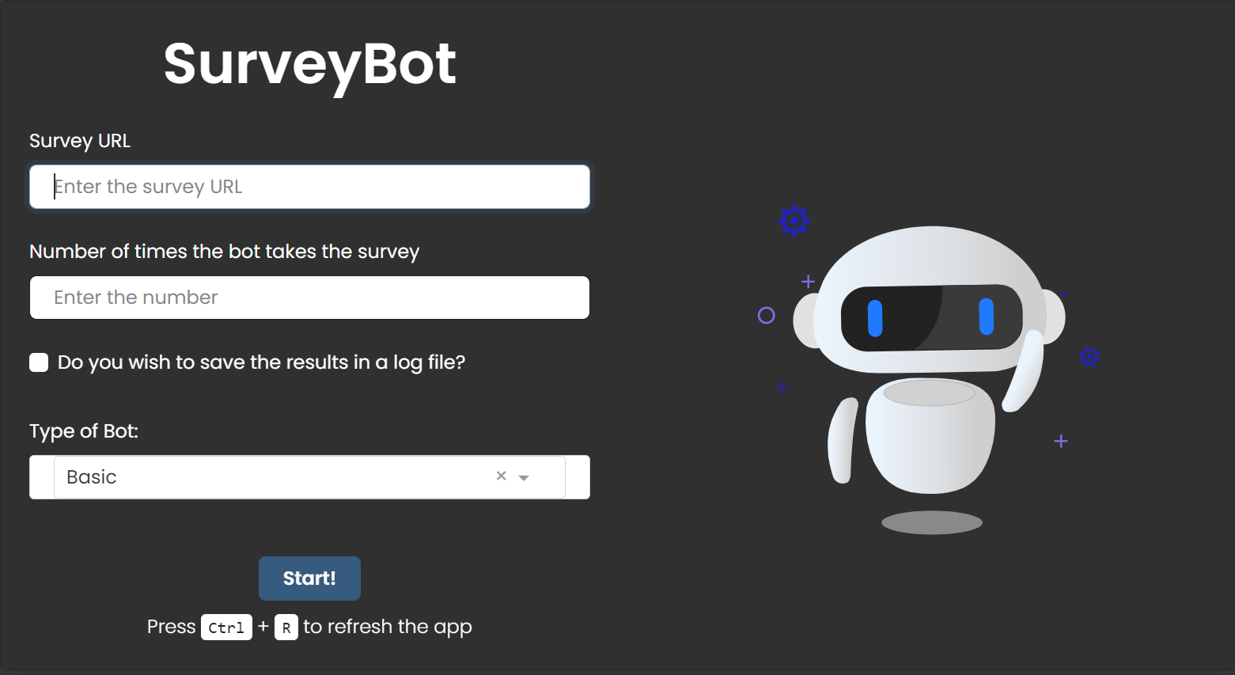
Sample Applications

Slide 5
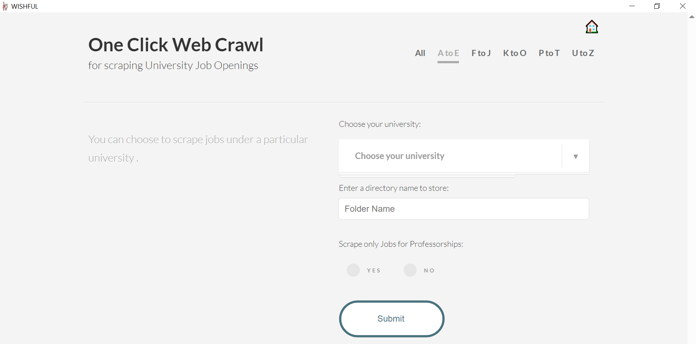
Sample Applications

Slide 6
01.
THEORY LESSON
CSS
Boring yet Important!!!

Slide 7
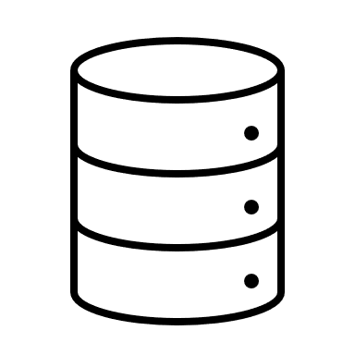

How does the web work?
DB
File System
HTTP Request
HTTP Response
Web Browser
Web Server

Slide 8

Onto Web Scraping
Web Crawling
Web Scraping
Definition: Web crawling is the process of systematically browsing the web to index and discover new pages. This is the technique used by search engines like Google to index the content of websites so that it can be searched later.
Purpose: The main goal is to discover and collect URLs (web addresses) of pages on the internet.
Definition: Web scraping involves extracting specific pieces of data from web pages. It's more focused and precise compared to crawling, and it's often used to collect specific information like prices, product details, or reviews from websites.
Purpose: The goal is to extract and structure data from web pages, usually for analysis or use in other applications.

Slide 9
What can we scrape from the web?
DATA
WEBSITE
HTML
XML
HTML is the standard language used to create web pages. It’s designed to structure the content (text, images, links, etc.) that you see on a website.
XML is a flexible, general-purpose language used to store and transport data. Unlike HTML, XML does not define how the data should look; it only defines the structure of the data.

Slide 10
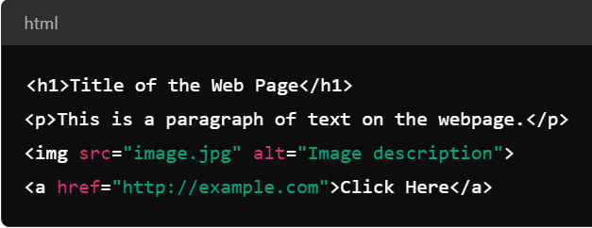
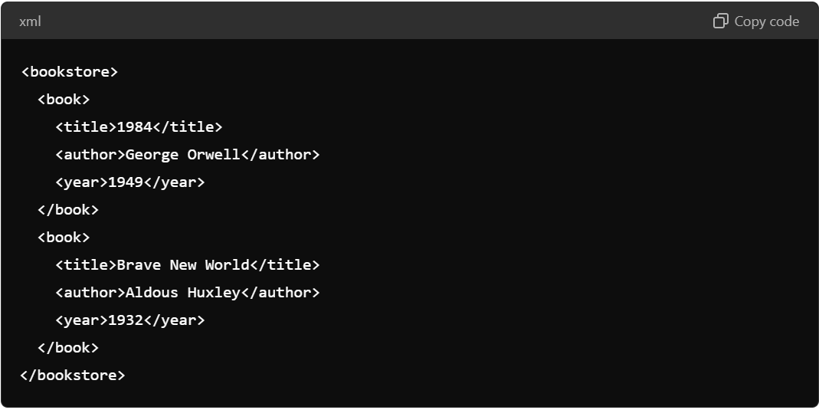
HTML vs. XML

Slide 11
HTML vs. XML
Both HTML and XML are about organizing data.
HTML: Focuses on how data is displayed (visual presentation)
XML: Focuses on how data is structured (meaningful data storage)
HTML is like an instruction sheet for a website that says, "Make this heading bold,“ or "Put this image here."
XML is like a catalog of information, such as a list of books, where you don’t care how it looks but care that it’s clearly labeled and structured.

Slide 12
What is Parsing?
Parsing means breaking down or analyzing a document's structure to understand and work with its components.
HTML parsing is the process of reading an HTML document (webpage) and converting it into a structured format that is easier to navigate and manipulate programmatically.

Slide 13
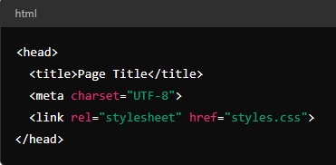
Let‘s understand HTML
HTML Tags
HTML tags define the structure and content of a webpage. Tags are like containers that hold content and give it meaning (e.g., headings, paragraphs, links).
Tags come in pairs (mostly) : an opening tag (e.g., <h1>) and a closing tag (e.g., </h1>)
<head>: Contains metadata about the webpage (information that isn’t displayed directly on the page).

Slide 14
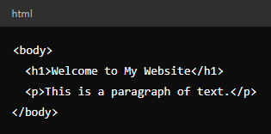
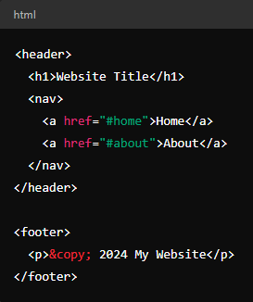
Let‘s understand HTML
HTML Tags
<body>: Holds the visible content of the webpage. Everything inside the <body> tag is rendered on the screen—text, images, links, etc.
<header>: Represents introductory content or navigational links, typically appearing at the top of the page
<footer>: Contains footer content such as copyright info, links to terms of service, and social media icons.

Slide 15
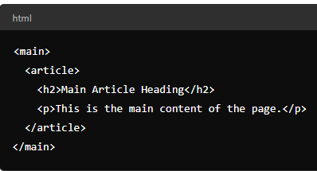
Let‘s understand HTML
HTML Tags
<main>: Represents the primary content of the page, which is unique to that page.
<body> holds everything on the page (headers, footers, etc.)
<main> contains the central content that is the focus of the page and excludes navigation, branding, and repeated elements.

Slide 16
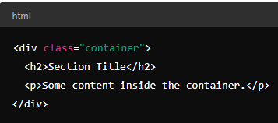
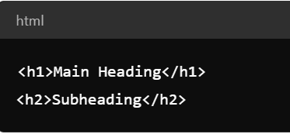
Let‘s understand HTML
HTML Tags
<div>: A generic container for grouping and styling content. It doesn’t add any meaning to the content but helps organize it.
<h1> and <h2>: Used for headings. <h1> is for the main title, and <h2> for subheadings

Slide 17
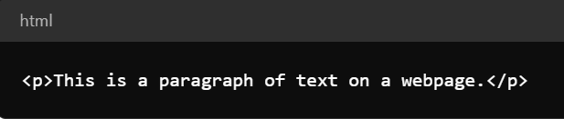
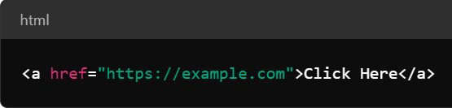
Let‘s understand HTML
HTML Tags
<p>: Defines a paragraph of text
<a>: Defines a hyperlink that links to another webpage or resource

Slide 18
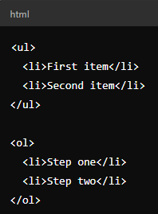
Let‘s understand HTML
HTML Tags
<li>, <ul>, <ol>:
Lists of items, where:
<ul>: Creates an unordered list (bullets)
<ol>: Creates an ordered list (numbers)
<li>: Defines each item in the list.

Slide 19
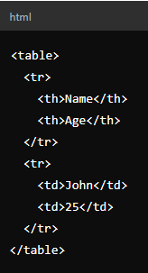
Let‘s understand HTML
HTML Tags
<table>, <tr>, <td>, <th> : Defines a table structure to display tabular data.
<table>: Creates a table
<tr>: Table row
<td>: Table cell (data)
<th>: Table header cell.

Slide 20

Let‘s understand HTML
HTML Tags
<img>: Embeds an image in the page. Requires the src attribute to specify the image source and the alt attribute for accessibility.

Slide 21
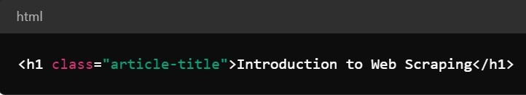
Let‘s understand HTML
HTML ATTRIBUTES
Attributes provide additional information about a tag. They appear inside the opening tag. Example: The href attribute in the <a> tag tells where the link points to.
Tags define the structure (headings, paragraphs, links)
Attributes give more detailed information (like URLs or classes) that help you target specific elements
In web scraping, both tags and attributes guide you to the exact data you want to extract from a webpage.

Slide 22
The Start Point
Sample WEBSITE
Area of interest
Inspect TAGS
How is it stored?
Look for the HTML tags
Text of Interest
Inspect attributes
Where is the text stored?
Look for the attributes within the tag
https://www.w3schools.com/html/html_attributes.asp

Slide 23
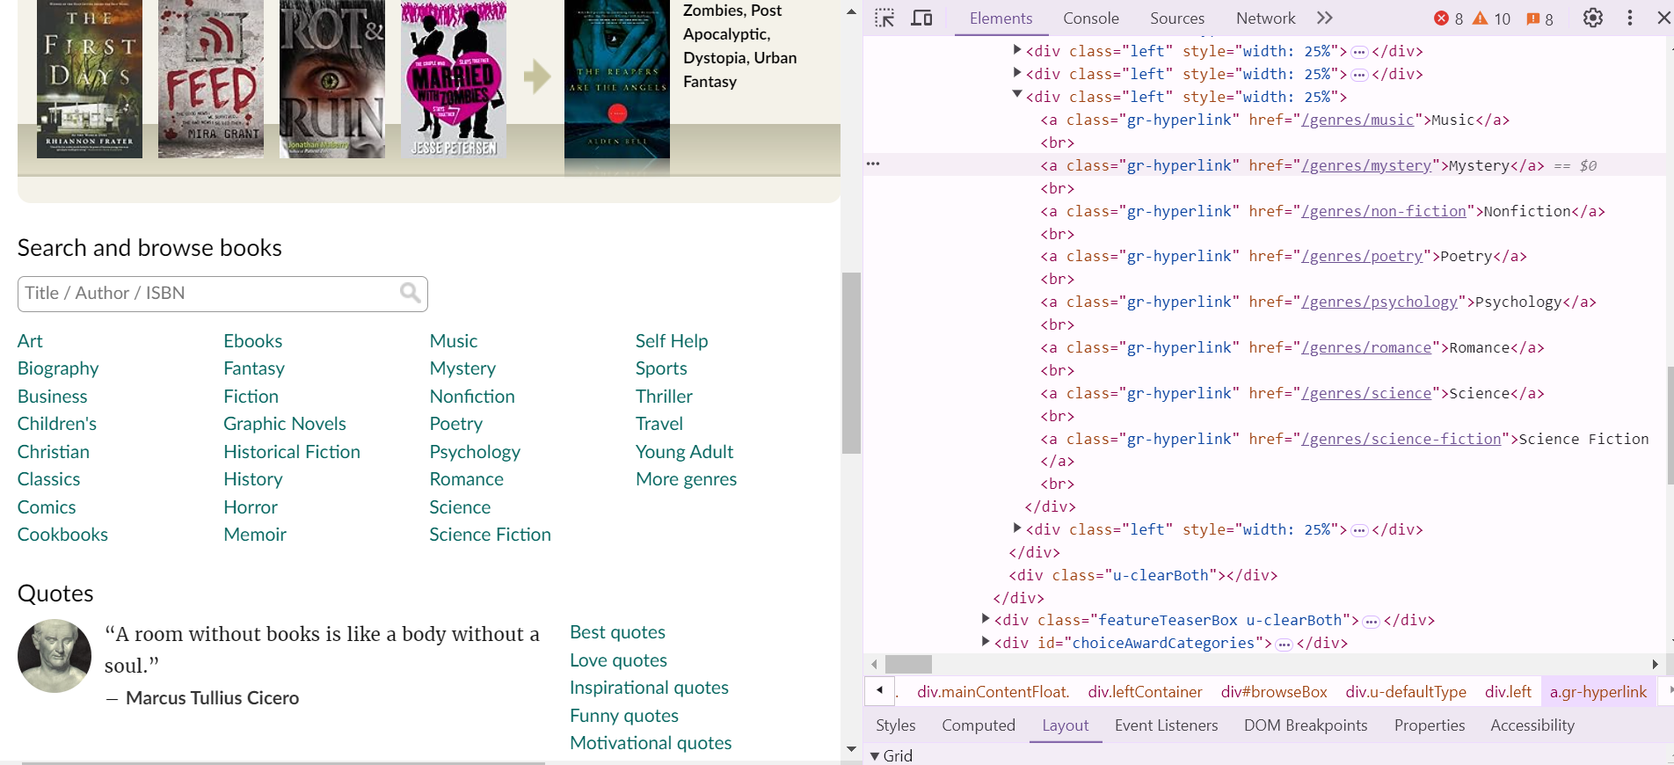



The Start Point
Sample WEBSITE

Slide 24
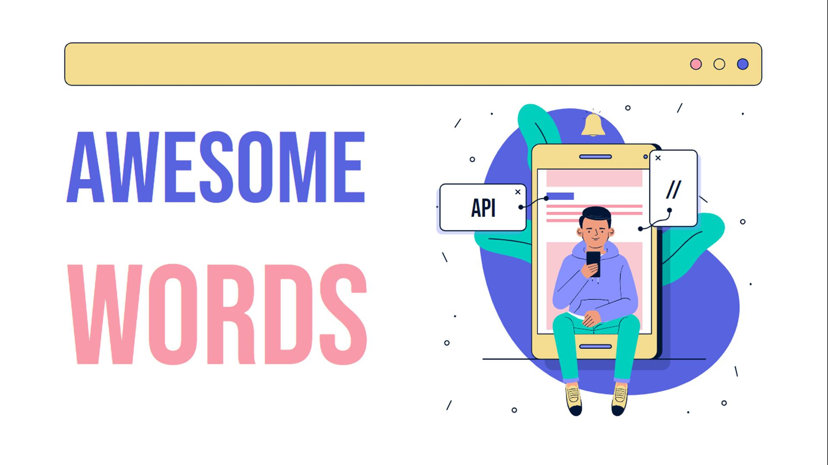
Let‘s Experiment!
  Choose your
  website and
  inspect

Slide 25

Ok I know this; now what?
Open SOURCE LIBRARIES
Paid API‘s
Beautiful Soup, Mechanical Soup, Selenium
ZenRows, ScraperApi,
ScrapingBee

Slide 26
Let‘s talk about Beautiful Soup
Beautiful Soup
What is Beautiful Soup?
A Python library for web scraping that parses HTML and XML documents. Allows easy extraction of data from websites.
Why Beautiful Soup?
Simplifies working with HTML structure. Handles messy or poorly formatted HTML. Integrates easily with Python libraries like requests.
Key Components
- find() and find_all(): to locate elements by tags
- Navigating HTML trees
- Extract text and attributes from tags.

Slide 27
Beauty of Beautiful Soup
Plus POints
Handling Malformed HTML
HTML/XML Parsing
Text Manipulation
Search and Extract Data
Integration with Parsers
Community Support
https://beautiful-soup-4.readthedocs.io/en/latest/

Slide 28
Finding element(s) using SOUP
Find()
FIND_ALL()
Retrieves the first matching element.
Retrieves all matching elements as a list.
FIND_PARENT(S)
SELECT
Finds elements using CSS selectors.
Finds the parent or parents of an element
https://www.crummy.com/software/BeautifulSoup/bs4/doc/

Slide 29
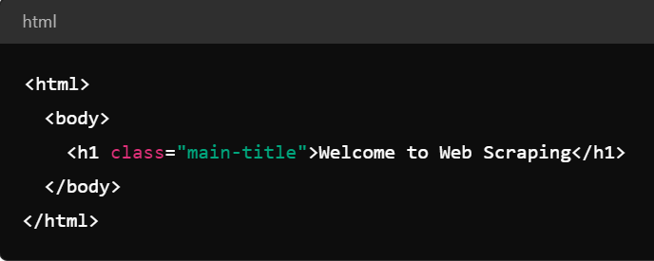
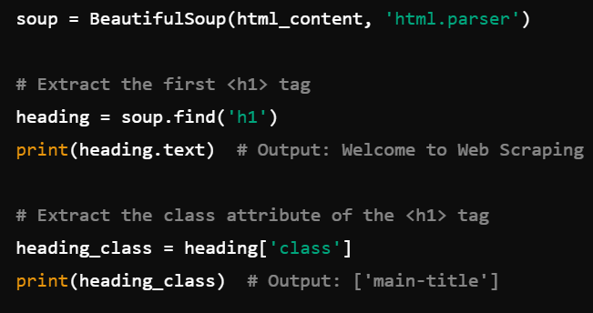
HTML and Beautiful Soup
Using find() to Extract a Single Tag

Slide 30
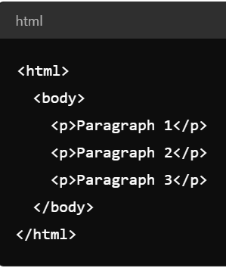
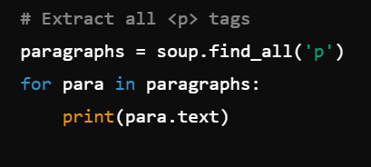
HTML and Beautiful Soup
Using find_all() to Extract a Multiple Tags

Slide 31
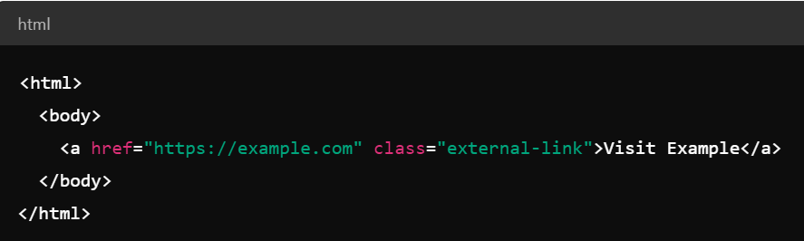
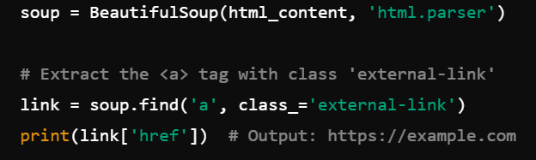
HTML and Beautiful Soup
Using find() with Attributes

Slide 32
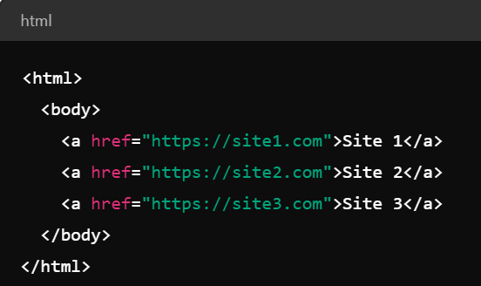
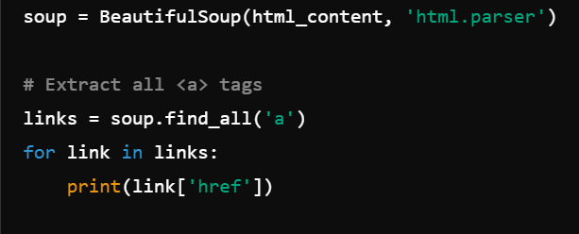
HTML and Beautiful Soup
Using find_all() with Attributes

Slide 33
HTML and Beautiful Soup
Using find_all() with Attributes

Slide 34
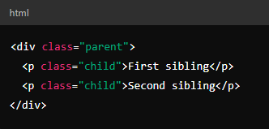
HTML and Beautiful Soup
Parent-Child Relationship:
In HTML, elements are often nested inside one another.
The parent element contains one or more child elements.
Sibling Relationship:
Siblings are elements that share the same parent.
They are located at the same level in the HTML tree.
Here, the <div> is the parent, and the <p> is the child. Both <p> elements are siblings because they are inside the same parent <div>.

Slide 35
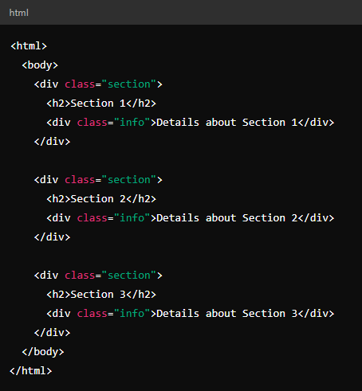
HTML and Beautiful Soup
Scenario: You want to extract the "info" content for Section 2, but all sections have the same class for their "info“ divs.

Slide 36
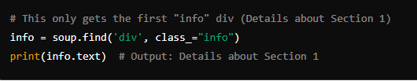
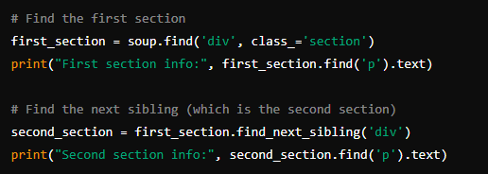
HTML and Beautiful Soup
Using Class Attribute Alone (Inefficient):
Using Tree Structure and Siblings (Correct Approach):

Slide 37
Let’s try this out!!

Slide 38
02.
Moving to Selenium
CSS

Slide 39
What can Soup not do?
NOT SO Plus POints
No JavaScript Execution
Limited Web Interaction
No Built-in Crawling Capabilities
Not Optimized for Large-Scale Scraping
No Anti-Scraping Countermeasures
Cannot Parse Non-HTML Content

Slide 40
What are these jargons?
HTML
Structures the content
JAVASCRIPT
Adds interactive functionality
CSS
Styles the appearance

Slide 41
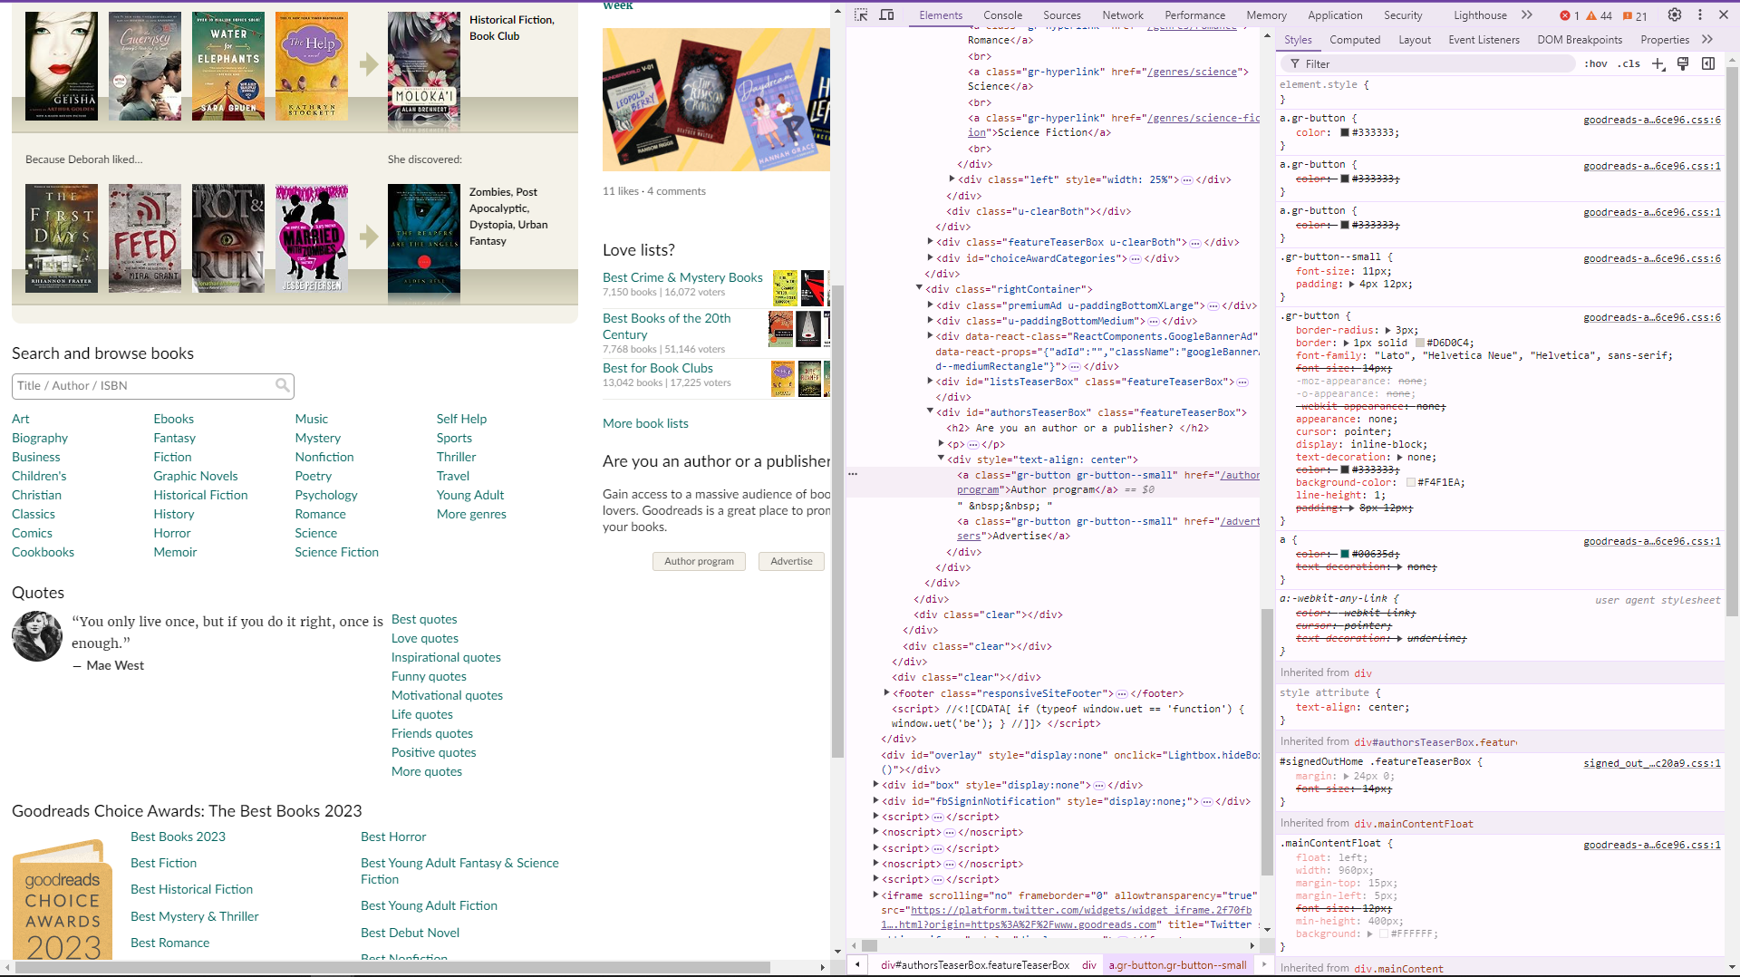

Slide 42
Selenium to Rescue
Selenium
What is Selenium?
Tool for automating web browsers. It allows you to interact with web pages as if you were a user.
Why Selenium?
It can handle dynamic content generated by JavaScript, such as loading data after a page load, dropdowns, and other interactive elements.
Key Components
- WebDriver: The WebDriver controls the browser
- Action Chains: You can simulate more complex interactions
- Explicit Waits: Selenium can wait for certain elements to load or become clickable

Slide 43
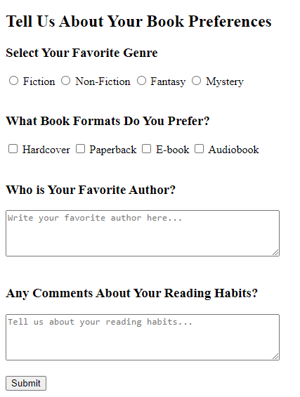
What can Selenium do?

Slide 44
Finding element(s) using SELENIUM
By.ID
By.XPATH
Using unique
id
Navigating the structure (when ID/ Name is not available)
By.LINK_TEXT
By.NAME
Using name (often in forms)
Link using exact text
https://selenium-python.readthedocs.io/locating-elements.html

Slide 45
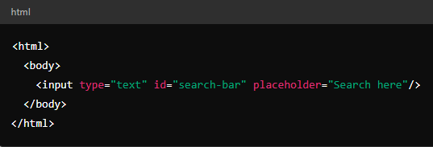
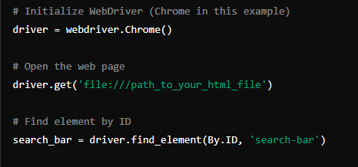
HTML & Selenium
Using By.ID in Selenium

Slide 46
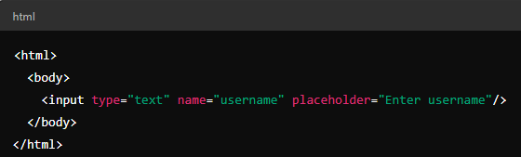
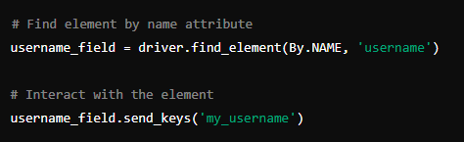
HTML & Selenium
Using By.NAME in Selenium

Slide 47
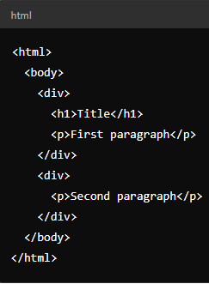

HTML & Selenium
Using By.XPATH in Selenium
// allows you to search for elements anywhere in the document without specifying their exact location in the HTML structure.

Slide 48
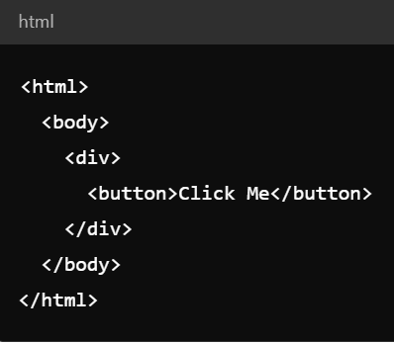
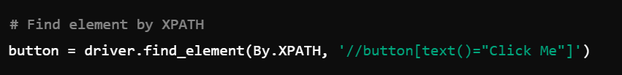
HTML & Selenium
Using By.XPATH in Selenium

Slide 49
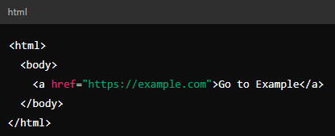
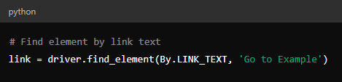
HTML & Selenium
Using By.LINK_TEXT in Selenium

Slide 50



Selenium and Interactions
J.K. Rowling

Slide 51
Let’s try this out!!

Slide 52
03.
Practical LESSON
Let’s get the hands dirty!!!

Slide 53
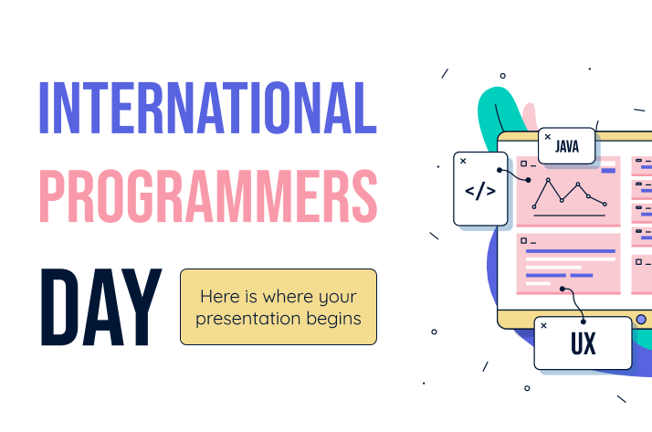
Ethical Concerns
Respect Website Terms of Service
Avoid Overloading Servers
Respect Data Privacy
Respect Robots.txt
Provide Attribution When Necessary
Use Data for Legitimate Purposes

Slide 54
Conclusion
Web scraping is a process that requires patience, creativity, and experimentation
There’s no one-size-fits-all solution; each project may need a unique approach
Keep experimenting and iterating until you find what works best.

Slide 55
THANKS!
Do you have any questions?
shahania@dzhw.eu
broneske@dzhw.eu

